Slide 1
Lincolnshire Crime & Policing Survey 2018/19 Research Debrief Presentation
Prepared for: Marc Jones, Police & Crime Commissioner for Lincolnshire 04/02/19 v3.0
© Habit5 2019

Slide 2
Contents
Background & methodology
Sample profile
Survey findings
Key Metrics Dashboard
Summary findings and recommendations
Next steps

Slide 3
Background & methodology

Slide 4
Objectives What we needed the research to achieve
The objectives for the research were to:
Actively engage and consult with the people of Lincolnshire regarding crime and policing, in a statistically robust and truly representative manner
Enhance and deepen understanding of their…
Methods of reporting crime
Current priorities for policing in Lincolnshire
Preferred approach to expenditure on, and budgeting for, policing in Lincolnshire
Knowledge of the role of the PCC and initiatives taken by the office holder in Lincolnshire
Provide the data and insights to make evidence-based strategic decisions
Support messaging, communications and public relations by the PCC himself and the permanent office of the PCC
Create benchmark data to support evaluating the impact of new initiatives upon public opinion in the future.
Compare year-on-year trends versus the survey in 2017

Slide 5
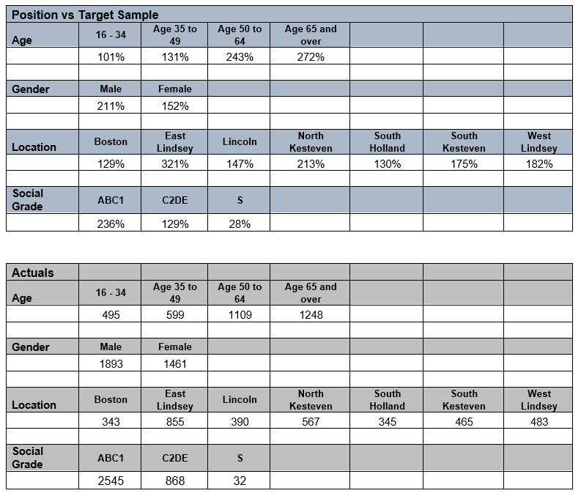
Who we needed to understand Permanent residents of Lincolnshire
The ONS mid-year 2017 population estimate for Lincolnshire of 599,746 Adults aged 18+ was used to calculate the target sample required, in order to achieve a Confidence Interval of ±6 or better for each of the demographic segments on the right at the 95% Confidence Level.
The Confidence Interval for the sample as whole, at the County Level is ± 1.66 (± 1.81 in 2017).
Actual completed surveys achieved are shown beside the target. All target sample levels were met and exceeded for each segment.
NB No target sample volume was set for participants categorising their Socio Economic Group as ‘S’ = Full Time Students.
Confidence Level & Confidence Interval # The total sample size was based on a 95% Confidence Level and a minimum Confidence Interval by segment of ± 6.
This is to ensure the statistical significance of the results for each segment. It means that had we surveyed everyone in our segment population the answer to a given question would fall within 6 percentage points of our research result (in either direction) on 95 occasions out of 100.

Slide 6
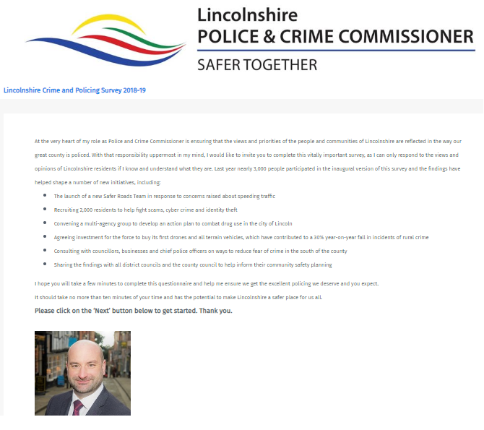
How we conducted the research Online Quantitative Survey
An online quantitative survey was used titled the: ‘Lincolnshire Crime and Policing Survey 2018-19’. Sponsorship of the survey was explicitly ascribed in the introduction to Marc Jones, as Police & Crime Commissioner for Lincolnshire.
The survey was device responsive across: desktop computers, tablets and smartphones.
3,449 fully completed surveys were achieved, an increase of 543 on the 2,906 achieved in 2017.
All participants were qualified as being:-
16 years of age and older
Permanently resident in Lincolnshire
Fieldwork was conducted between 12th December 2018 and 16th January 2019.
All fieldwork was conducted in accordance with the MRS Code of Conduct.

Slide 7
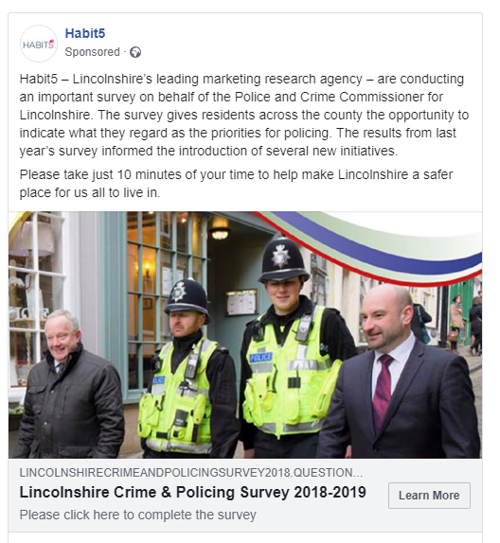
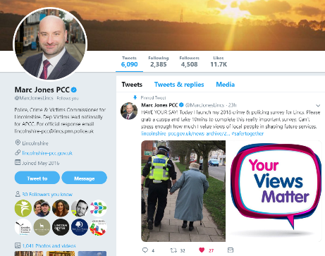
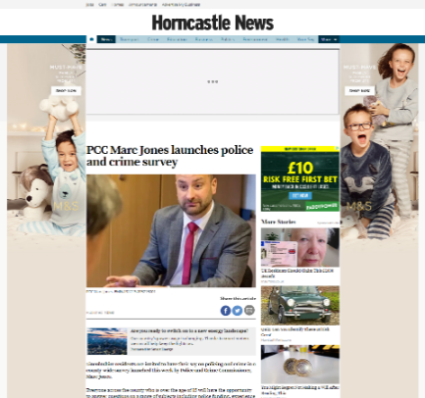
Recruiting participants Several different media channels were deployed
In order to maximise and diversify public engagement with the survey, several different media channels were used to promote it.
Paid for sources were only introduced once the no-cost sources had been fully leveraged, in order to minimise overall participant recruitment costs.
These two sources accounted for 435 participants within the total sample of 3,449 or 12.6%.
Twitter, LCHS & Lincs Alert | PR from Press Release | Facebook Promotion | Consumer Panel
As well as a pinned tweet on Lincs PCC Twitter feed, survey invitations were sent to Lincs Alert members and via the e-newsletter for the Lincolnshire Community Health Service. | Several press releases were issued referencing the survey. The story was picked up and featured on multiple news websites & in offline publications. | A promotional (PPC) post on Facebook featuring a link to the survey was deployed & targeted to specific demographic segments that proved harder to reach in other channels. | Research Now access panel participants were recruited again to top-up sample amongst harder to reach target segments.

Slide 8
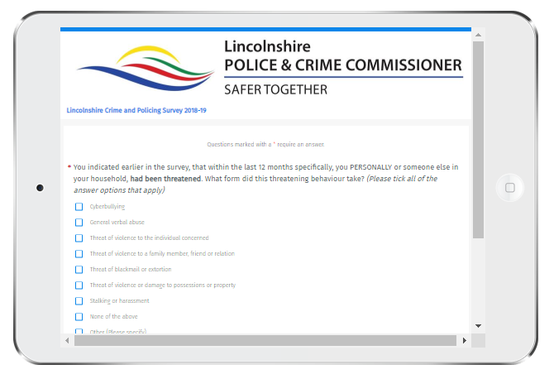
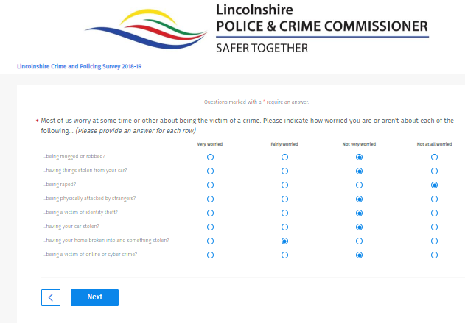
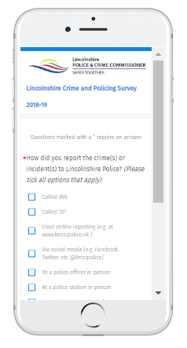
Survey structure Balancing comprehensiveness & completion rate
Question themes
Age (Under 16s screened out)
Residence (Non-Lincolnshire screened out)
Duration of residence
Fear of crime
Experience of crime in the last year
Incidence of crime experienced
Perspective on local area
Threatening behaviour
Online/Cyber crime
Crime Reported Y/N
Method of Reporting Crime
Crime Reporting Satisfaction
Crime Reporting future intent Emergency/Non Emergency
Budget Allocation splits
999 call resource deployment
Police Funding perceptions
Council Tax Band / Prepared to Pay
Initiative Awareness
Initiative Impact
Awareness of PCC role
Relationship Status
Employment Status
Occupation
Marital Status
Gender
Ethnicity
Expression of interest in joining Community Panel
Other matters
The completion rate for the survey was 74%* (cf 73% in 2017) We regard any rate of 70%+ as satisfactory for this length of survey. *Excludes Research Now participants who were incentivised to complete.

Slide 9
Sample profile
NB All survey results
shown in this presentation relate to the 2018-19 survey unless annotated otherwise.

Slide 10
Sample variation from the resident population of Lincolnshire
As detailed within the Background section, we set minimum target sample volumes by:
Gender
Age Band
Local Authority
Socio Economic Group (e.g. ABC1, C2DE)
but we did not cap sample at these minimum volumes, as we wished to engage and enfranchise as many people as possible. In 2018-19 we were utilising more channels that could not simply be “switched off” (e.g. Lincs Alert, LCHS, PR, etc). We therefore have higher overweight positions within demographic segments who exhibit a greater propensity to engage in completing the survey.
Within analysis we have the option to:
A] Use the largest sample possible if isolating results amongst a particular demographic e.g. 35-49 year-olds
B] Use the total sample available
C] Use a weighted sample to reflect the distribution of the actual population of Lincolnshire on a given demographic, rather than their incidence in the total sample population e.g. examining results re-calibrating age band to adjust for our overweight amongst 50+ year-olds

Slide 11
The greater propensity of males to complete the survey was accentuated in 2018-19.
The Community Panel membership and new media channels should be deployed in the next annual survey to engage a higher proportion of females. New question topics and suitable images for social media posts would also usefully support this aim.
As last year use of participant recruitment channels that support targeting by gender (e.g. Facebook PPC, Research Now) played an important role in achieving a more appropriately balanced sample than natural participation rates would have delivered.
Gender
NB In absolute terms more females (+105) completed the survey in 2018 v 2017.
Unweighted Base: Female (n=2,819), Male (n=3,364), Non binary / third gender (n=20), Prefer not to say (n=136), Prefer to self-describe (please complete box below) (n=5)

Slide 12
The 65+ population account for a higher proportion of survey participants in 2018, with the share amongst under 50s falling.
What is your age?
NB In absolute terms only -114 fewer under 50s completed the survey in 2018 v 2017.
All of the paid for participants were targeted to be under 50, except for residents of Boston Borough.
Unweighted Base: 16 to 34 (n=986), 35 to 49 (n=1,315), 50 to 64 (n=1,989), 65+ (n=2,061)

Slide 13
Relationship status profile at a macro level closely resembles that in 2017, with 74% of participants in a relationship with another person.
Which of the following best describes your current relationship status?
Unweighted Base: Married (n=3,939), Widowed (n=272), Divorced (n=392), Separated (n=85), In a domestic partnership or civil union (n=297), Single, but cohabiting with a significant other (n=511), Single, never married (n=636), Prefer not to say (n=219)

Slide 14
93% of the survey sample self-categorises as White British, which mirrors the population of Lincolnshire
What is your ethnic group?
Unweighted Base: White British (n=5,915), Mixed/multiple ethnic groups (e.g. White and Black African) (n=31), White European (n=142), Asian/Asian British (n=31), Black/African/Caribbean/Black British (n=15), Other ethnic group (E.g. Arab) (n=15), Prefer not to say (n=202)

Slide 15
42% of the 2018 Survey sample are retired, obviously this closely correlates with the older sample profile.
Which of the options below best describes your employment status? 2018
Unweighted Base: Retired (n=1,439), Working Full Time (n=1,232), Working Part Time (n=404), Home-maker (n=105), Volunteering (n=67), Carer (n=54), Student (n=70), Unemployed (n=65), Intern, Trainee or Apprentice (n=9)

Slide 16
In 2018, a slightly higher proportion of survey participants have been drawn from Socio Economic Groups B and C1.
Please select the description below which best matches the occupation of the chief income earner in your household, or their occupation prior to retirement:
Unweighted Base: CEO, board director, senior manager, professional, high level civil service or public sector manager (n=1,090), Middle manager, owner of a small business, mid-level civil service or public sector manager (n=2,177), Junior manager, supervisor, clerical worker or self employed (n=1,330), Skilled manual worker (n=987), Semi or unskilled manual worker (n=370), Unemployed (n=316), Full time or part time student in higher or further education (n=81)

Slide 17
74% of survey participants in 2018 fall into the ABC1 Socio Economic Groups.
Please select the description below which best matches the occupation of the chief income earner in your household, or their occupation prior to retirement:
NB In absolute terms +64 more C2DE Adults completed the survey in 2018 v 2017.

Slide 18
Two thirds of participants live in households comprising of two adults, whilst nearly a fifth (19%) are the sole adult in their household.
How many adults aged 18 or over, including yourself, live in your household?
Unweighted Base: 1 (n=640), 2 (n=2,289), 3 (n=366), 4 (n=114), 5 (n=36)

Slide 19
Just under a quarter (23%) of participants live in a household with at least one occupant aged 17 years or under.
How many children and young people, aged 17 and under, live in your household?
Unweighted Base: None (n=2,666), 1 (n=361), 2 (n=297), 3 (n=91), 4 (n=22), 5+ (n=8)

Slide 20
As in 2017, more than two thirds (69%) of the sample have been resident in the same local area for at least 10 years.
How long have you lived in the LOCAL AREA? (By LOCAL AREA, we mean within about a 15 minute walk from your current address)
Unweighted Base: <12m (n=173), >12m <2 yrs (n=231), >2 yrs <3 yrs (n=257), >3yrs <5yrs (n=469), >5yrs <10yrs (n=857), >10yrs <20yrs (n=1,556), 20yrs + (n=2,807)

Slide 21
The absolute sample size in each Local Authority has risen year on year with the exception of Lincoln City
Which local authority are you permanently resident in? (Please select one option only)
Is there any obvious explanation for the dramatic rise in participation levels from residents in East Lindsey?
Unweighted Base: Boston Borough (n=614), East Lindsey (n=1,438), Lincoln City (n=838), North Kesteven (n=1,036), South Holland (n=651), South Kesteven (n=881), West Lindsey (n=893)

Slide 22
In 2018, residents of East Lindsey account for a quarter of the total sample, with South Kesteven the most under-represented Local Authority (-5% points) relative to the distribution of the actual population of the county.
Which local authority are you permanently resident in? (Please select one option only)
Lincoln City has experienced the largest year-on-year fall in proportional share of the sample (-4% points).
Ahead of the next annual survey, new ways to engage higher numbers of residents in: South Kesteven, Lincoln City and South Holland should be identified.
Unweighted Base: Boston Borough (n=614), East Lindsey (n=1,438), Lincoln City (n=838), North Kesteven (n=1,036), South Holland (n=651), South Kesteven (n=881), West Lindsey (n=893)

Slide 23
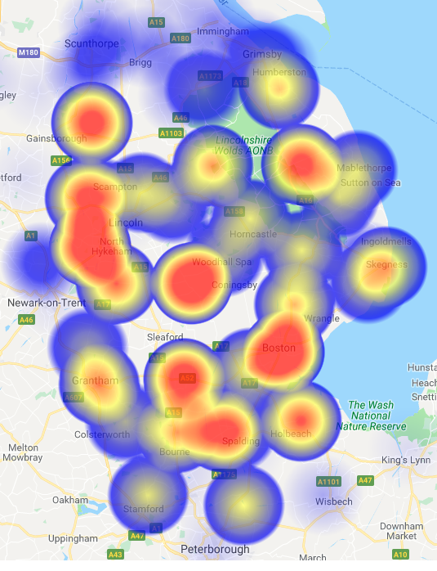
14 postcode areas supplied in excess of one hundred survey participants each.
Postcode | Count
PE21 | 237
LN4 | 236
LN6 | 220
NG34 | 195
LN1 | 185
PE11 | 185
LN2 | 184
DN21 | 177
LN11 | 169
PE12 | 140
LN5 | 129
NG31 | 115
PE10 | 106
LN8 | 105
PE22 | 92
PE25 | 83
DN36 | 81
PE20 | 72
PE6 | 69
LN9 | 64
PE23 | 63
PE9 | 60
PE24 | 57
LN12 | 52
LN13 | 46
LN10 | 44
NG33 | 41
LN3 | 36
NG32 | 35
LN7 | 24
NG23 | 11
DN32 | 9
DN35 | 8
DN17 | 6
DN16 | 5
DN20 | 5
DN15 | 4
DN31 | 4
DN34 | 4
PE13 | 4
Heat map and ranked list of survey participants by postcode area.

Slide 24
The participant sample aligns quite closely to property categorisations for Council Tax with the exceptions of Band A which is markedly under-represented in the overall sample and Band D which is markedly over-represented, as was the case in 2017 as well.
Please indicate from the options below which Council Tax Band your place of residence falls into.
Distribution of the sample by Council Tax Band
For the purpose of comparison we have excluded participants answering: ‘Exempt’ ‘Not required to pay’ and ‘Don’t know’.

Slide 25
Survey findings

Slide 26
At a headline level there has been a marginal year-on-year rise in the impact on quality of life caused by ‘Fear of Crime’ across all residents completing the survey. The mean score for this dimension has worsened by 0.28.
How much is YOUR OWN quality of life affected by FEAR OF CRIME on a scale from 1 to 10, where 1 is no effect and 10 is a total effect on your quality of life?
NB As this is a mean score rating on a 10 point rating scale, a rating scale increase of 1 equates roughly to a 10% point increase. Therefore this increase of 0.28 broadly equates to a 2.8% move.
Source: Lincolnshire Crime and Policing Survey 2018-19. Conducted by Habit5 Limited.
Unweighted Base: 2017 (n=2,906), 2018 (n=3,444)

Slide 27
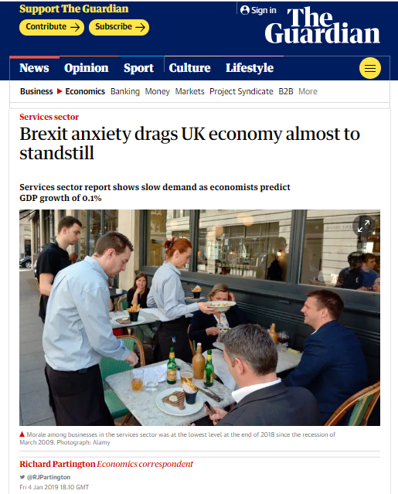
The impact of Fear of Crime on quality of life has risen very slightly year-on-year both in the mid-range and higher up the scale.
How much is YOUR OWN quality of life affected by FEAR OF CRIME on a scale from 1 to 10, where 1 is no effect and 10 is a total effect on your quality of life?
Are we living in slightly more anxious times for the country as a whole?
Unweighted Base: 1 (n=692), 2 (n=1,172), 3 (n=1,120), 4 (n=644), 5 (n=890), 6 (n=522), 7 (n=524), 8 (n=496), 9 (n=151), 10 (n=139)

Slide 28
As might be expected, very high impact on quality of life as a consequence of Fear of Crime is more widespread amongst people living in single adult households.
How much is YOUR OWN quality of life affected by FEAR OF CRIME on a scale from 1 to 10, where 1 is no effect and 10 is a total effect on your quality of life? Single Adult Household .v. Total Sample
Base: 1 (n=321), 2 (n=547), 3 (n=530), 4 (n=292), 5 (n=388), 6 (n=249), 7 (n=229), 8 (n=223), 9 (n=61), 10 (n=66)

Slide 29
In many instances the impact on quality of life prompted by a Fear of Crime is likely to be heavily influenced by actual recent experience, as 70% of the individuals providing a 10 rating, have some direct experience of crime within the last 12 months.
Yes/No to Any Experience of Crime by Fear of Crime rating – 2018 only
As might be anticipated, the share of people who have experienced at least one crime within the last 12 months, rises in a pretty linear fashion as ratings themselves rise.
Unweighted Base: 2018/1 (n=371), 2018/2 (n=625), 2018/3 (n=589), 2018/4 (n=352), 2018/5 (n=502), 2018/6 (n=274), 2018/7 (n=296), 2018/8 (n=272), 2018/9 (n=90), 2018/10 (n=73)

Slide 30
Fear of Crime appears to have risen in East Lindsey, North Kesteven and West Lindsey, whilst falling by a smaller margin in Boston Borough and South Kesteven.
Fear of Crime by Local Authority, Survey Year - Mean Scores
Fear of Crime is again lowest in North Kesteven at a mean rating score of 3.73 despite the year-on-year rise in that authority.
Fear of Crime remains highest in absolute terms in Boston Borough at a mean rating score of 5.03.
Unweighted Base: Boston Borough/2017 (n=271), Boston Borough/2018 (n=343), East Lindsey/2017 (n=584), East Lindsey/2018 (n=854), Lincoln City/2017 (n=448), Lincoln City/2018 (n=390), North Kesteven/2017 (n=470), North Kesteven/2018 (n=566), South Holland/2017 (n=306), South Holland/2018 (n=345), South Kesteven/2017 (n=416), South Kesteven/2018 (n=465), West Lindsey/2017 (n=411), West Lindsey/2018 (n=481)
Source: Lincolnshire Crime and Policing Survey 2018-19. Conducted by Habit5 Limited.

Slide 31
The rise in West Lindsey is amongst the Fearful, whereas in East Lindsey and North Kesteven it is chiefly amongst the Anxious.
Local Authority by Fear of Crime Groups, Survey Year Groups
Unweighted Base: Boston Borough/2017 (n=271), Boston Borough/2018 (n=343), East Lindsey/2017 (n=584), East Lindsey/2018 (n=854), Lincoln City/2017 (n=448), Lincoln City/2018 (n=390), North Kesteven/2017 (n=470), North Kesteven/2018 (n=566), South Holland/2017 (n=306), South Holland/2018 (n=345), South Kesteven/2017 (n=416), South Kesteven/2018 (n=465), West Lindsey/2017 (n=411), West Lindsey/2018 (n=481)
Source: Lincolnshire Crime and Policing Survey 2018-19. Conducted by Habit5 Limited.

Slide 32
Residents of Boston Borough make up 17% of the ‘Fearful’ segment (those rating 8-10) with C2 Skilled manual workers accounting for a fifth of that same segment (20%).
How much is YOUR OWN quality of life affected by FEAR OF CRIME on a scale from 1 to 10, where 1 is no effect and 10 is a total effect on your quality of life? (Grouped profile)

Slide 33
In aggregate levels of worry about being a victim of a specific crime have reduced very slightly or in a minority of cases remained stable year-on-year.
Most of us worry at some time or other about being the victim of a crime. Please indicate how worried you are or aren't about each of the following... (Please provide an answer for each row)
Unweighted Base: ...having your home broken into and something stolen? (n=6,351), ...being mugged or robbed? (n=6,351), ...having your car stolen? (n=6,351), ...having things stolen from your car? (n=6,351), ...being raped? (n=6,351), ...being physically attacked by strangers? (n=6,351), ...being a victim of online or cyber crime? (n=6,351), ...being a victim of identity theft? (n=6,351)

Slide 34
‘Burglary from the home’ remains both the most widespread and deep-seated worry for residents, with the ratings for this virtually unchanged from last year.
Most of us worry at some time or other about being the victim of a crime. Please indicate how worried you are or aren't about each of the following... (Please provide an answer for each row)

Slide 35
The perceived scale of problem that different crimes represent in the local area have universally reduced and more markedly than worry about being a victim.
Thinking about your immediate LOCAL AREA, how much of a problem, if at all, are each of the following...
Unweighted Base: ...noisy neighbours or loud parties? (n=6,351), ...antisocial street drinking? (n=6,351), ...vandalism, graffiti and other deliberate damage to property or vehicles? (n=6,351), ....burglary and theft from private property? (n=6,351), ...people using or dealing drugs? (n=6,351), ...people being drunk or rowdy in public places? (n=6,351), ...physical assault or other violent behaviour? (n=6,351), ...speeding traffic? (n=6,351)

Slide 36
‘Speeding traffic’ continues to be perceived as the most widespread significant problem (61%), with a quarter of participants regarding it as a very big problem in their local area.
Thinking about your immediate LOCAL AREA, how much of a problem, if at all, are each of the following...
‘Burglary and theft from private property’ are the next most widely perceived significant problems (38%), followed by ‘People using or dealing drugs’ (35%).

Slide 37
As last year a higher proportion (71%) of residents of South Holland regard ‘speeding traffic’ as a big problem, but this has fallen year-on-year by 3% points.
Thinking about your immediate LOCAL AREA, how much of a problem, if at all, are each of the following...speeding traffic?
The lowest proportion of residents of Lincoln City (54%) see ‘speeding traffic’ as a big problem but this may in part be a consequence of the dampening affect of congestion. That said can anything be learnt from any traffic calming measures in the city?
Unweighted Base: Boston Borough/2018 (n=343), East Lindsey/2018 (n=854), Lincoln City/2018 (n=390), North Kesteven/2018 (n=566), South Holland/2018 (n=345), South Kesteven/2018 (n=465), West Lindsey/2018 (n=481)

Slide 38
Perception of ‘physical assault and other violent behaviour’ as a big problem locally, continues to be much more widespread (48%) in Boston Borough than elsewhere but the proportion of residents there holding this view has fallen by 13% points YOY.
Thinking about your immediate LOCAL AREA, how much of a problem, if at all, are each of the following...physical assault or other violent behaviour?
Quite marked year-on-year falls have been experienced in other authorities too:
South Holland (-8%),
Lincoln City (-9%)
East Lindsey (-8%).
Unweighted Base: Boston Borough/2018 (n=343), East Lindsey/2018 (n=854), Lincoln City/2018 (n=390), North Kesteven/2018 (n=566), South Holland/2018 (n=345), South Kesteven/2018 (n=465), West Lindsey/2018 (n=481)

Slide 39
The proportion of residents regarding ‘people being drunk or rowdy in public places’ in the local area as a big problem has reduced across all local authorities.
Thinking about your immediate LOCAL AREA, how much of a problem, if at all, are each of the following...people being drunk or rowdy in public places?
Unweighted Base: Boston Borough/2018 (n=343), East Lindsey/2018 (n=854), Lincoln City/2018 (n=390), North Kesteven/2018 (n=566), South Holland/2018 (n=345), South Kesteven/2018 (n=465), West Lindsey/2018 (n=481)

Slide 40
Residents of North Kesteven are the most likely (37%) to regard ‘people using or dealing drugs’ as ‘no problem at all’ in their local area.
Thinking about your immediate LOCAL AREA, how much of a problem, if at all, are each of the following...people using or dealing drugs?
Unweighted Base: Boston Borough/2018 (n=343), East Lindsey/2018 (n=854), Lincoln City/2018 (n=390), North Kesteven/2018 (n=566), South Holland/2018 (n=345), South Kesteven/2018 (n=465), West Lindsey/2018 (n=481)

Slide 41
South Holland (51%) rather than Boston Borough (47%) is now the local authority with the highest proportion of residents who regard burglary and theft from private property as a big problem.
Thinking about your immediate LOCAL AREA, how much of a problem, if at all, are each of the following...burglary and theft from private property?
Unweighted Base: Boston Borough/2018 (n=343), East Lindsey/2018 (n=854), Lincoln City/2018 (n=390), North Kesteven/2018 (n=566), South Holland/2018 (n=345), South Kesteven/2018 (n=465), West Lindsey/2018 (n=481)

Slide 42
40% of residents of Boston Borough perceive ‘vandalism…etc’ to be a big problem, but the proportion doing so has fallen by 3% points year-on-year.
Thinking about your immediate LOCAL AREA, how much of a problem, if at all, are each of the following…vandalism, graffiti and other deliberate damage to property or vehicles?
Unweighted Base: Boston Borough/2018 (n=343), East Lindsey/2018 (n=854), Lincoln City/2018 (n=390), North Kesteven/2018 (n=566), South Holland/2018 (n=345), South Kesteven/2018 (n=465), West Lindsey/2018 (n=481)

Slide 43
Whilst ‘antisocial street drinking’ is perceived as a very big problem by more people in Boston Borough (29%) than elsewhere, those seeing it this way have reduced by 12% points year-on-year.
Thinking about your immediate LOCAL AREA, how much of a problem, if at all, are each of the following...antisocial street drinking?
The % of participants seeing ‘antisocial street drinking’ as a very big problem has either fallen in five Local Authorities year-on-year.
Unweighted Base: Boston Borough/2018 (n=343), East Lindsey/2018 (n=854), Lincoln City/2018 (n=390), North Kesteven/2018 (n=566), South Holland/2018 (n=345), South Kesteven/2018 (n=465), West Lindsey/2018 (n=481)

Slide 44
‘Noisy neighbours or loud parties’ is the least likely issue investigated to be regarded as a big problem.
Thinking about your immediate LOCAL AREA, how much of a problem, if at all, are each of the following...noisy neighbours or loud parties?
Unweighted Base: Boston Borough/2018 (n=343), East Lindsey/2018 (n=854), Lincoln City/2018 (n=390), North Kesteven/2018 (n=566), South Holland/2018 (n=345), South Kesteven/2018 (n=465), West Lindsey/2018 (n=481)

Slide 45
Claimed experience of crime personally or within their household has fallen year-on-year across all categories with the exception of ‘online crime’ and ‘vehicle theft’.
Within the last 12 months specifically, have you PERSONALLY or has anyone else in your household...
Whilst the biggest year-on-year % point fall was registered by
‘…been threatened in any way’ (-4% points) this remains the most likely experience, with over a fifth of participants citing it.
Crime Experience - Yes

Slide 46
Within the last 12 months specifically, have you PERSONALLY or has anyone else in your household...
Crime Experience - Yes
Unweighted
When a weighting for Age Band (Actual % split in the population of Lincolnshire) is applied to the research sample, the incidence levels of experiencing different types of crime, in most cases rise by 1-2%.
However, the year-on-year falls in incidence remain true for: ‘theft of personal possessions’, ‘physically attacked’ and ‘been threatened in any way’. As does the sole YOY rise for ‘Online crime…’

Slide 47
Experience of crime appears to have reduced year-on-year across all local authorities with the exception of Boston Borough where it appears to be broadly stable.
Local Authority by Yes to Any Experience of Crime by Local Authority by Survey Year
Unweighted Base: Boston Borough/2017 (n=271), Boston Borough/2018 (n=343), East Lindsey/2017 (n=584), East Lindsey/2018 (n=854), Lincoln City/2017 (n=448), Lincoln City/2018 (n=390), North Kesteven/2017 (n=470), North Kesteven/2018 (n=566), South Holland/2017 (n=306), South Holland/2018 (n=345), South Kesteven/2017 (n=416), South Kesteven/2018 (n=465), West Lindsey/2017 (n=411), West Lindsey/2018 (n=481)

Slide 48
The C2DE Socio Economic Groups have a 6% point higher likelihood of having experienced a crime of some kind within the last 12 months than the ABC1 segment.
SEG by Yes/No to Any Experience of Crime
Unweighted Base: Total (n=3,444), 2018/ABC1 (n=2,545), 2018/C2DE (n=867)

Slide 49
Men have a 3% point higher likelihood of having experienced a crime of some kind within the last 12 months than women.
Gender by Yes/No to Any Experience of Crime
Unweighted Base: Total (n=3,353), 2018/Female (n=1,460), 2018/Male (n=1,893)

Slide 50
16–34 year-olds are more than twice as likely to have experienced a crime within the last 12 months, than are the over 65s.
Age Band by Yes/No to Any Experience of Crime
Unweighted Base: Total (n=3,444), 2018/16 to 34 (n=495), 2018/35 to 49 (n=596), 2018/50 to 64 (n=1,105), 2018/65+ (n=1,248)

Slide 51
The collective instances of claimed experience of crime within the last 12 months are markedly higher in Boston Borough than other authorities (NB Not unique individuals).
Within the last 12 months specifically, have you PERSONALLY or has anyone else in your household...
Crime Experience (Yes) by Local Authority - 2018

Slide 52
Being threatened continues to be the experience most likely to be encountered on multiple occasions.
How many times, within the last 12 months, did each of the events listed below happen to you PERSONALLY or a member of your household...
The frequency with which threat is experienced has barely changed from the survey in 2017.
The frequency with which online crime, etc is experienced appears to be increasing slightly year-on-year.

Slide 53
22% of all Boston Borough participants or a member of their household, has been threatened more than once within the last 12 months (64% of all those threatened).
How many times, within the last 12 months, did each of the events listed below happen to you PERSONALLY or a member of your household... Boston Only
Unweighted Base: ...had a car, van, motorcycle, or other motor vehicle stolen? (n=7), ...had anything stolen, off or from inside, a vehicle? (n=7), ...had anything stolen from your home? (n=7), ...had any personal possessions stolen whilst in a public place? (n=7), ...been physically attacked by another person? (n=7), ...been threatened in any way? (n=7), ...been subject to online crime, cyber crime and/or identity theft? (n=7)

Slide 54
Non-white British participants, as in 2017, continue to be more likely to claim to have experienced every category of crime than White British participants.
During the last 12 months specifically, have you PERSONALLY or has anyone else in your household...
The year-on-year increase in claimed experience of online crime is markedly higher amongst Non-White British participants.
Does any more need to be done to support cyber secure behaviour amongst ethnic minorities?

Slide 55
As well as being generally more widespread, the threatening behaviour in Boston Borough is more likely to relate to violence to the person.
You indicated earlier in the survey, that within the last 12 months specifically, you PERSONALLY or someone else in your household, had been threatened. What form did this threatening behaviour take? (Please tick all of the answer options that apply)
Unweighted Base: General verbal abuse (n=514), Threat of violence to the individual concerned (n=288), Threat of violence to a family member, friend or relation (n=166), Threat of violence or damage to possessions or property (n=188), Threat of blackmail or extortion (n=49), Cyberbullying (n=68), Stalking or harassment (n=109), None of the above (n=20)

Slide 56
58% of participants who have experienced an online crime categorise it as an ‘online scam or fraud’, with nearly 50% indicating that it incorporated ‘phishing’.
You indicated earlier in the survey, that within the last 12 months specifically, you PERSONALLY or someone else in your household, had been subject to online crime, cyber crime and/or identity theft. Please indicate what happened by selecting the relevant options from the list below? (Please tick all of the answer options that apply)
Just under a quarter (23%) of online crime, claimed to have been experienced is categorised as incorporating identity theft.
Unweighted Base: Online scam or fraud (n=343), Phishing: use fake email messages in an attempt to get personal information from internet users (n=288), Malware or computer virus: presence of software designed to disrupt, damage, or gain unauthorized access to a computer system (n=184), Identity theft: Misuse of personal information to impersonate another individual (n=138), Hacking: unauthorised access to, or control over, computer network security systems for an illicit purpose (n=111), Cyberbullying: the use of electronic communication to bully a person, typically by sending messages of an intimidating or threatening nature (n=61), None of the above (n=30), Online incitement of racial hatred, violence or terrorism (n=16), Grooming: making sexual advances to a minor(s) (n=5), Distribution of indecent images e.g. sexting (n=7)

Slide 57
35-49 year-olds are the most likely segment to have reported a crime or incident within the last 12 months, with students the least likely to have done so.
Despite the marked disparities in the claimed experience of crime by Local Authority, the incidence of reporting of it is very uniform.
With Boston Borough the lowest at 27%. (Consequence of loss of faith in the outcome? Social inhibitors?)
Have you reported a crime(s) or incident(s) to Lincolnshire Police within the last 12 months?
NB The results here correlate closely with 12 month norm for England & Wales of 29% having contact with the police.
Unweighted Base: Yes (n=981), No (n=2,463)

Slide 58
Participants experiencing a crime (personally or a member of their household) within the last 12 months, were more than twice as likely (49%) to report a crime than were those without this experience (21%). However, over half of them (51%) did NOT report a crime within the same time period.
In interpreting these figures at least two things are worth bearing in mind:
A] Another member of their household (Not the participant) may have taken responsibility for reporting a crime
B] Participants who have witnessed and reported a crime or other incident to the police may not consider that they themselves have ‘experienced’ the crime. This population will make up a significant proportion of the 21% in the chart.
Reported a crime by Survey Year Groups Yes/No by Any Experience of Crime
Unweighted Base: Yes (n=981), No (n=2,463)

Slide 59
Exactly two thirds of the participants who had reported a crime or incident to Lincolnshire Police within the last 12 months did so by calling 101 (18.5% of the total sample)
How did you report the crime(s) or incident(s) to Lincolnshire Police? (Please tick all options that apply)
Only 10% reported a crime or incident at a police station in person. This equates to 2.8% of the total survey sample.
Just under a quarter of individuals who reported a crime or incident to Lincolnshire Police within the last 12 months did so by calling 999. (6.4% of the total sample)
Unweighted Base: Called 101 (n=701), Called 999 (n=244), Used online reporting (e.g. at www.lincs.police.uk ) (n=160), To a police officer in person (n=143), At a police station in person (n=102), Via Neighbourhood Watch (n=38), Via social media (e.g. Facebook, Twitter, etc @lincspolice) (n=33), Via Crimestoppers (n=18), Other (n=1)

Slide 60
Reporting a crime or incident to a police officer in person, is most likely (30%) to result in the member of public feeling very satisfied.
The driver of this satisfaction cannot simply be explained by the personal nature of this method, as reporting a crime or incident in person at a police station engenders less than half (13%) the proportion ‘very satisfied’ outcomes.
Please use the rating scale below to indicate how satisfied or dissatisfied you were overall, with your experience of using the method(s) listed to report crime(s) or incident(s) to Lincolnshire Police.
None of the satisfaction levels attained by the different methods of contact here match the 61% figure achieved in the ‘Public Perceptions of Policing in England and Wales 2018’ research, published in January 2019.

Slide 61
Reporting a crime or incident ‘At a police station in person’ delivers the second lowest satisfaction rating of any method, only bettering that for use of Crimestoppers.
Please use the rating scale below to indicate how satisfied or dissatisfied you were overall, with your experience of using the method(s) listed to report crime(s) or incident(s) to Lincolnshire Police.
Service Satisfaction Mean Scores
Via Neighbourhood Watch achieves the second highest crime reporting satisfaction rating, exceeded only by reporting to a police officer in person.
Unweighted Base: To a police officer in person (n=144), Via Neighbourhood Watch (n=38), Called 999 (n=244), Called 101 (n=701), Used online reporting (e.g. at www.lincs.police.uk ) (n=161), Via social media (e.g. Facebook, Twitter, etc @lincspolice) (n=34), Other (n=144), At a police station in person (n=101), Via Crimestoppers (n=18)

Slide 62
Briefly describe in the text box below why you were dissatisfied with……. (Summary and selected examples)
999
I called as a large fight had broken out in Coop car park, 2am. I could see someone getting their head stamped on and kicked and the telephone agent asked me to go out to get a better description of them all. When I declined to get involved, I was told officers were too busy and would be there in an hour. They could hear the shouting and screams on the phone; it could have been a murder, ultimately.
I have had to call 999 4 times in the last year. Each time I was being threatened with physical violence and each time the operator told me it wasnt an emergency and put the phone down. 1 time ended in an assault.
I waited 4 hours for a police response after being verbally abused and attacked at my own home. No one responded. it was a proprity 1 response. I got a call back from the operator at 999 centre and they said sorry. and an officer would call back. its been 5 days now and no call back.
Nieghbour was being threatened next door by a man with a machete dialled 999 and was asked if neighbour was in the house safe. I replied he is in the house but man with machete was trying to break in. 999 replied ok your neighbour is safe please hang up and dial 101..
Summary - Almost all reasons for dissatisfaction relate to No response, Slow response or the call not being taken seriously enough.
101
After my call was answered I was put on hold and no one came to the phone so I eventually hung up
After reporting receiving messages threatening myself and my partner with severe violence, I called 101. Officers were due to attend that night however, they did not. They eventually came the next day, and whilst they were polite and made me feel safe, I was told I would hear back from them in a week. A week or two later, still no update so I called to chase for an update and was told an officer would contact me with an update either by phone or email, this was two months ago and to this date I still have not received any form of update. I don’t know if the suspect was questioned as I was told he would be, I don’t know the outcome, I have been kept in the dark and now I’ve quite frankly given up and lost all faith in the police.
Amount of time spent waiting for call to be answered
From initially making the call it took 28 minutes for the operator to answer. No action was taken or officer attendance.
Had to call numerous times to get through and person who answered seemed uninterested
No one even bothered to come round to see what happened
No police came on one occasion for 3 weeks. Did not listen to my big problems i am going through
Summary - Almost all reasons for dissatisfaction relate to: Length of time to answer call/deal with incident or no action taken by the police.

Slide 63
Online Reporting
Did not receive any further contact
Have not had feedback and we told them who did it
Haven’t seen any signs of the problem been dealt with.
I reported a crime and a pcso was sent to investigate who couldn’t be bothered, lied about the action being taken and was of less use then a normal member of the public
Summary - Almost all reasons for dissatisfaction relate to: No action being taken by the police
Reporting to a Police Officer in person
Lack of action despite clear offences
Lack of effective action
No discipline was taken against the other person concerned although the problem has been going on for years.
No outcome
Summary - Almost all reasons for dissatisfaction relate to: No action being taken by the police
Reporting to a Police Station
Didn't seem interested, just said it'll be probably sold in the pub for a tenner and just gave crime number
Didn't want to see me, despite physical threats and abuse. In danger and vulnerable young female
Disinterested box ticking G4S staff, PCSO's that are more interested in giving talks to primary school kids. Complaints not taken seriously. ‘Blind eye' turned to complaints about local businesses.
Every time I report a incident and turn up to the station the police is not interested and won’t do anything and when I have been assaulted the police won’t do nowt
Thought they didn't care
Was not taken seriously
Summary - Almost all reasons for dissatisfaction relate to; No action / Not interested
Crimestoppers/Neighbourhood Watch
I was not able to contact anybody very quickly for a quick response.
No response
Over 10 cars on 1 street was 'keyed ' scratched. Cars constantly damaged but nothing is changed or done
Nothing was dealt with.
Summary - No response / action taken

Slide 64
Unsurprisingly calling 999 is the method most likely to be used ‘in an emergency’ in the future to report a crime or incident.
If you had to report a crime or incident in the future which method would you be most likely to use: in an emergency? (Please select one answer option only)
Only 2% of participants indicate that they would report a future emergency at a police station in person.
Unweighted Base: Call 999 (n=2,626), Call 101 (n=356), Use online reporting (e.g. at www.lincs.police.uk ) (n=62), Via social media (e.g. Facebook, Twitter, etc @lincspolice) (n=9), To a police officer in person (n=22), At a police station in person (n=57), Via Neighbourhood Watch (n=8), Via Crimestoppers (n=4), Other (n=66)

Slide 65
Over two thirds of people (68%) indicate that they would call 101 to report a non-urgent matter in the future. However, reporting this ‘At a police station in person’ is the third most likely method to be used.
If you had to report a crime or incident in the future which method would you be most likely to use: for a non-urgent matter? (Please select one answer option only)
Unweighted Base: Call 101 (n=2,184), Use online reporting (e.g. at www.lincs.police.uk ) (n=395), At a police station in person (n=239), Call 999 (n=140), Other (n=104), To a police officer in person (n=60), Via social media (e.g. Facebook, Twitter, etc @lincspolice) (n=43), Via Neighbourhood Watch (n=32), Via Crimestoppers (n=13)

Slide 66
People are more likely, in the future, to report a non-urgent matter ‘At a police station in person’, if they: are over 50, live in Boston Borough or to a lesser extent Lincoln City, and/or fall into the C2DE Socio Economic Group.
If you had to report a crime or incident in the future which method would you be most likely to use: for a non-urgent matter? (“Yes” to experience of crime vs Reporting non-urgent matter at Police Station)
Conversely, people who are 35-49 years of age, live in West Lindsey or to a lesser extent North Kesteven, are much less likely than average to report a non-urgent matter ‘At a police station in person’.
Unweighted Base: Call 101 (n=2,184), Use online reporting (e.g. at www.lincs.police.uk ) (n=395), At a police station in person (n=239), Call 999 (n=140), Other (n=104), To a police officer in person (n=60), Via social media (e.g. Facebook, Twitter, etc @lincspolice) (n=43), Via Neighbourhood Watch (n=32), Via Crimestoppers (n=13)

Slide 67
‘Child abuse’ is allocated the highest share of budget by participants at 10.14%, with ‘Hate crime’ receiving the lowest share at 3.14%.
The categories allocated the highest budgets correlate quite closely with those prioritised in the most recent: ‘Public Perceptions of Policing in England and Wales 2018’ research: terrorism/extremism (49%), child sexual exploitation/ abuse (46%) and violent crime (41%).
Please imagine that you are in charge of the budgets for Lincolnshire Police. Use the slider to indicate what percentage (%) of the annual budget you would allocate to combat, prevent, or resolve, crimes and incidents falling within the categories listed below. (NB A running total is shown beneath the categories. Please ensure that your total response sums to 100%)
To what extent are policing budgets or resources hypothecated in this way? Are there any parallels or points of comparison that can be drawn.

Slide 68
Participants appear to allocate budgetary resource using slightly different criteria to allocation of police officer resource, albeit when asked at different times.
Net position on additional police officers deployed or removed by category. – 2017 Survey
Pink box denotes top five budget allocation in the 2018 Survey.
NB Budget choices could be relative and comparative whereas the police offer choices in 2017 were absolutes e.g. deployments across five selected priorities only.
*
* Not included as an answer option in 2018 Survey
Base: Violence, disorder & antisocial behaviour (n=1,716), Domestic abuse (n=695), Hate crime (n=373), Firearms offences (n=127), Serious organised crime (n=524), Neighbourhood policing (n=1,833), Drug abuse and dealing (n=1,791), Fraud & money laundering (n=315), Terrorism & extremism (n=386), Child abuse (n=880), Rape or other sexual crimes (n=680), Human traffiking & missing persons (n=458), Traffic offences & road safety (n=1,504), Theft & burglary (n=1,733), Rural crime (e.g. hare coursing, poaching, etc) (n=1,171)

Slide 69
Perceived immediacy of ‘risk to life’ appears to explain which incidents participants’ choose to deploy officers to in response to a 999 emergency call. That said, the ‘severity’ of the road traffic accident’, which has an officer deployed to it by 9 out of 10 people, was not referenced within the wording of this answer option.
Please imagine that you managing the deployment of police officer resource in response to 999 emergency calls received within the last few minutes. Eleven calls have come in but you only have five police officers available to deploy. Please indicate below which five calls you would deploy an officer to respond to. (Please select exactly five answer options)The caller reports...
An officer would get deployed to each of these five incidents.
Would current policing protocols and practice have made the same decisions under this scenario? (NB Without further qualifying information).
Unweighted Base: ...that a loud party is taking place next door (n=147), ...that they have been a victim of fraud (n=184), ...that they have witnessed lead being taken from a church roof (n=703), ...that they have received threats both online and in person (n=831), ...a disturbance on the street outside their home (n=1,403), ...drug dealing taking place in their street (n=1,936), ...that their partner is being abusive towards them (n=2,002), ...that their property has been broken into (n=2,006), ...that they have seen someone who is suicidal (n=2,395), ...a vulnerable person has gone missing (n=2,565), ...a road traffic accident has occurred (n=3,094)

Slide 70
More females prioritise - vulnerable person, suicidal person, and domestic abuse; whereas more males prioritise – burglary, drug dealing and disturbance nearby
Please imagine that you managing the deployment of police officer resource in response to 999 emergency calls received within the last few minutes. Eleven calls have come in but you only have five police officers available to deploy. Please indicate below which five calls you would deploy an officer to respond to. (Please select exactly five answer options)The caller reports...
Female priorities for deployment seem to be more focused upon the acuteness of human vulnerability per se, whereas males are more likely to illustrate empathy with proximity and perceived external threat to the home/household of the caller.
Unweighted Base: ...that a loud party is taking place next door (n=138), ...that they have been a victim of fraud (n=182), ...that they have witnessed lead being taken from a church roof (n=688), ...that they have received threats both online and in person (n=810), ...a disturbance on the street outside their home (n=1,356), ...drug dealing taking place in their street (n=1,885), ...that their property has been broken into (n=1,956), ...that their partner is being abusive towards them (n=1,951), ...that they have seen someone who is suicidal (n=2,331), ...a vulnerable person has gone missing (n=2,498), ...a road traffic accident has occurred (n=3,015)

Slide 71
83% of Lincolnshire residents believe that the funding level for the Lincolnshire Police should be ‘Increased’.
Do you believe that the funding for Lincolnshire Police should be… /2018-19 Survey
This compares with 82% of participants in the 2017 Survey indicating that they saw the funding level for Lincolnshire Police as ‘Inadequate’ or ‘Restrictive’ on the closest equivalent question asked.
Unweighted Base: Increased (n=2,851), Maintained (n=530), Reduced (n=64)

Slide 72
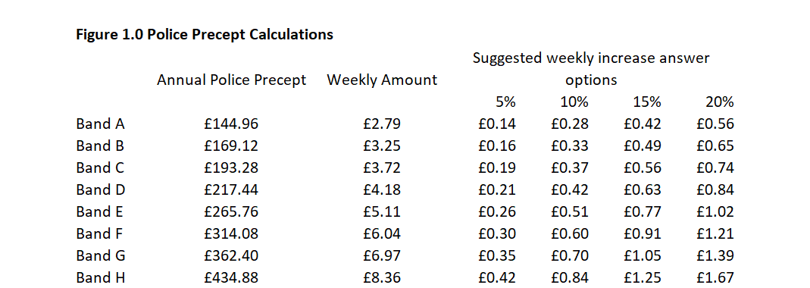
Approach Calculating potential increase options to the Precept
We calculated potential weekly increase options to the Police Precept in Lincolnshire by Council Tax Band, as illustrated in the table at Figure 1.0 below:-
The distribution of properties in Lincolnshire by Council Tax Band, is as illustrated in the table at Figure 2.0 below:-

Slide 73
Of those participants who selected a Council Tax Band the highest proportion chose Band C (22%).
Please indicate from the options below which Council Tax Band your place of residence falls into. /2018-19 Survey
Distribution of the sample by Council Tax Band
NB Participants who did not know their Council Tax Band were invited to answer using the Band D increase options.
Unweighted Base: Band A (approx. £1,100 per year) (n=591), Band B (approx. £1,300 per year) (n=624), Band C (approx. £1,480 per year) (n=749), Band D (approx. £1,650 per year) (n=705), Band E (approx. £2,000 per year) (n=246), Band F (approx. £2,380 per year ) (n=123), Band G (approx. £2,750 per year) (n=67), Band H (approx. £3,300 per year) (n=14), I am exempt from paying council tax (n=63), I am not required to pay council tax (e.g. Under 18 years of age) (n=39), I don't know (n=224)

Slide 74
The participant sample aligns quite closely to property categorisations for Council Tax with the exceptions of Band A which is markedly under-represented in the overall sample and Band D which is markedly over-represented, as was the case in 2017 as well.
Please indicate from the options below which Council Tax Band your place of residence falls into.
For the purpose of comparison we have excluded participants answering: ‘Exempt’ ‘Not required to pay’ and ‘Don’t know’.
Distribution of the sample by Council Tax Band

Slide 75
Across the entire sample the proportion of participants selecting the highest weekly incremental amount has risen by 4 percentage points year-on-year
Please indicate below how much more you would be prepared to pay per week, for more police officers and a better policing service in LINCOLNSHIRE. (Please select one option)
Distribution of incremental weekly increase option selected year-on-year
The proportion of participants who are ‘Not prepared to pay any more’ has fallen by 8 percentage points year-on-year.
Unweighted Base: Low (n=674), Medium (n=895), High (n=1,064), Highest (n=2,284), Nothing (n=1,230)

Slide 76
Residents who are married, 65+ and/or retired are slightly more likely to be prepared to pay 20% more per week for the Police Precept.
Please indicate below how much more you would be prepared to pay per week, for more police officers and a better policing service in LINCOLNSHIRE. (Please select one option)
Profile 20% more vs Not prepared to pay any more
Residents who: live in East Lindsey,
fall within SEG C2 and/or have lived in the same local area for 20 years + are slightly more likely to ‘Not be prepared to pay any more’ in Police Precept.

Slide 77
Residents of West Lindsey (42%) and North Kesteven (41%) are the most likely to select the highest weekly increase +20%
Please indicate below how much more you would be prepared to pay per week, for more police officers and a better policing service in LINCOLNSHIRE. (Please select one option) /2018-19 Survey
Level of increase selected by Local Authority
Residents of East Lindsey and Lincoln City are the most likely to ‘Not be prepared to pay any more’.
Unweighted Base: 2018/Boston Borough (n=322), 2018/East Lindsey (n=838), 2018/Lincoln City (n=366), 2018/North Kesteven (n=555), 2018/South Holland (n=336), 2018/South Kesteven (n=455), 2018/West Lindsey (n=470)

Slide 78
20% more per week in the Police Precept is the mode answer option selected by residents in all Council Tax Bands with the exception of Band G, where 15% more is the mode answer.
Please indicate below how much more you would be prepared to pay per week, for more police officers and a better policing service in LINCOLNSHIRE. (Please select one option)
Unweighted Base: 2018/Band A (n=591), 2018/Band B (n=624), 2018/Band C (n=749), 2018/Band D (n=928), 2018/Band E (n=246), 2018/Band F (n=123), 2018/Band G (n=67), 2018/Band H (n=14)

Slide 79
The average incremental amount per week that residents are prepared to pay has risen year-on-year across all Council Tax Bands bar one, with Band B the only exception.
Please indicate below how much more you would be prepared to pay per week, for more police officers and a better policing service in LINCOLNSHIRE. (Please select one option) /2018-19 Survey
Taken in the round, residents have accepted the higher incremental amounts used year-on-year as answer options in the survey.
The average is higher in every Council Band than in the 2017 Survey, with the exception of Band B which had an average weekly incremental amount of £0.51 last year.

Slide 80
The average incremental amount residents are prepared to pay increased year-on-year in every Council Band when those not prepared to pay more are included in the calculation
Please indicate below how much more you would be prepared to pay per week, for more police officers and a better policing service in LINCOLNSHIRE. (Please select one option) /2018-19 Survey
Each of the mainstream Brands A to D registered a year-on-year double digit percentage increase in the overall average incremental amount residents are prepared to pay.
(e.g. Band A average in 2018-19 £0.35 versus £0.29 in 2017 = +19.59% year-on-year excl. rounding)

Slide 81
The average % increase in Police Precept selected by residents is 15% or higher in each Council Tax Band, when those unprepared to pay more are excluded from the calculation
Please indicate below how much more you would be prepared to pay per week, for more police officers and a better policing service in LINCOLNSHIRE. (Please select one option) /2018-19 Survey

Slide 82
The lowest overall average % increase selected is 12% in Bands A and D, when those unprepared to pay more are included in the calculation
Please indicate below how much more you would be prepared to pay per week, for more police officers and a better policing service in LINCOLNSHIRE. (Please select one option) /2018-19 Survey

Slide 83
The mode (42%) incremental amount selected by residents in Band A is £0.56 or 20% more
Please indicate below how much more you would be prepared to pay per week, for more police officers and a better policing service in LINCOLNSHIRE. (Please select one option) /2018-19 Survey
Band A
A higher percentage (15%) of residents of Band A, than in any of the other bands, select the lowest % increase.
Unweighted Base: £0.15 per week (n=86), £0.31 per week (n=93), £0.42 per week (n=54), £0.56 per week (n=251), Not prepared to pay more (n=107)

Slide 84
The mode (37%) incremental amount selected by residents in Band B is £0.65 or 20% more
Please indicate below how much more you would be prepared to pay per week, for more police officers and a better policing service in LINCOLNSHIRE. (Please select one option) /2018-19 Survey
Band B
Unweighted Base: £0.18 per week (n=76), £0.36 per week (n=82), 0.49 per week (n=138), £0.65 per week (n=229), Not prepared to pay more (n=99)

Slide 85
The mode (36%) incremental amount selected by residents in Band C is £0.74 or 20% more
Please indicate below how much more you would be prepared to pay per week, for more police officers and a better policing service in LINCOLNSHIRE. (Please select one option) /2018-19 Survey
Band C
Unweighted Base: £0.20 per week (n=78), £0.41 per week (n=98), £0.56 per week (n=185), £0.74 per week (n=270), Not prepared to pay more (n=120)

Slide 86
The mode (39%) incremental amount selected by residents in Band D is £0.84 or 20% more
Please indicate below how much more you would be prepared to pay per week, for more police officers and a better policing service in LINCOLNSHIRE. (Please select one option) /2018-19 Survey
Band D
Unweighted Base: £0.23 per week (n=118), £0.46 per week (n=166), £0.63 per week (n=127), £0.84 per week (n=360), Not prepared to pay more (n=155)

Slide 87
Very nearly half (49%) of the participants in Band E select £1.02 or a 20% incremental increase per week
Please indicate below how much more you would be prepared to pay per week, for more police officers and a better policing service in LINCOLNSHIRE. (Please select one option) /2018-19 Survey
Band E
Unweighted Base: £0.28 per week (n=23), £0.56 per week (n=34), £0.77 per week (n=30), £1.02 per week (n=120), Not prepared to pay more (n=39)

Slide 88
Around £1.00 extra per week, seems to represent something of a watershed amongst residents in Band F
Please indicate below how much more you would be prepared to pay per week, for more police officers and a better policing service in LINCOLNSHIRE. (Please select one option) /2018-19 Survey
Band F
Unweighted Base: £0.33 per week (n=11), £0.66 per week (n=10), £0.91 per week (n=42), £1.21 per week (n=47), Not prepared to pay more (n=13)

Slide 89
Band G is the only band in which the highest increase option is not the mode selection, here a 15% increase or £1.05 is the most widely selected option (39%)
Please indicate below how much more you would be prepared to pay per week, for more police officers and a better policing service in LINCOLNSHIRE. (Please select one option) /2018-19 Survey
Band G
Unweighted Base: £0.38 per week (n=2), £0.77 per week (n=5), £1.05 per week (n=26), £1.39 per week (n=24), Not prepared to pay more (n=10)

Slide 90
Whilst a very small sample, Band H is the most polarised, registering both the highest % selection (50%) of the highest increase & the highest propensity to not pay any more (21%)
Please indicate below how much more you would be prepared to pay per week, for more police officers and a better policing service in LINCOLNSHIRE. (Please select one option) /2018-19 Survey
Band H
Unweighted Base: £0.46 per week (n=1), £0.92 per week (n=0), £1.25 per week (n=3), £1.67 per week (n=7), Not prepared to pay more (n=3)

Slide 91
40% of participants are aware of the Community Speed Watch initiative on a prompted basis, with nearly a third claiming awareness of Mini Police.
Which, if any, of the initiatives or programmes listed below, were you aware of, before starting to complete this survey (Please tick all that apply).
In the next annual survey we could potentially seek to evaluate Spontaneous (e.g. unprompted) awareness of initiatives and programmes, in a free text answer format.
With 84% prompted awareness, Crimestoppers is very nearly as widely known as Neighbourhood Watch (87%).
Unweighted Base: Brew with Stu (n=66), None of the above (n=151), Friends Against Scams (n=307), Stop Hate UK (n=455), Victims Lincs (n=518), Mini Police (n=1,111), Community Speed Watch (n=1,384), Lincs Alert (n=1,834), Crimestoppers (n=2,907), Neighbourhood Watch schemes (n=3,002)

Slide 92
Widespread prompted awareness does not translate into perceived significant benefit. For the 15% who are aware of Victims Lincs 45% of them see it as being of ‘great benefit’, more than for any other initiative.
Please indicate what you regard as the level of benefit that each of the initiatives listed below delivers to the community. (Please rate each one that you are aware of or tick ‘N/A’ if you are not aware of it) NB Only those that indicated awareness were invited to rate impact.

Slide 93
Key Metrics Dashboard

Slide 94
Key Metrics Dashboard
Metric | 2017 | 2018 | Year-on-Year Variance
Participants fully completing the survey | 2,906 | 3,449 | +543
Survey completion rate | 73% | 74% | +1%
Fear of Crime mean rating score | 4.00 | 4.28 | +0.28
Most widespread & deepest worry | ‘Burglary from the home’ 23% Very worried | ‘Burglary from the home’ 23% Very worried | Unchanged
Biggest perceived problem in local area – mean sore rating | ‘Speeding traffic’ 2.88 | ‘Speeding traffic’ 2.78 | -0.10
Most widespread experience of crime, either personally or member of household | ‘Been threatened in any way’ 25% | ‘Been threatened in any way’ 21% | -4%
Biggest increase in experience of crime by category | ‘Been subject to online crime’ 15% | ‘Been subject to online crime’ 16% | +1%
Views on funding level for Lincolnshire Police | ‘Inadequate’ or ‘Restrictive’ 82% | ‘Should be increased’ 83% | +1%* *Not exact same
% of participants selecting highest incremental increase (+20%) in weekly Police Precept for their Council Tax Band | 35% | 39% | +4%

Slide 95
Summary findings & recommendations

Slide 96
Survey participation
3,449 fully completed surveys were achieved, an increase of 543 on the 2,906 achieved in 2017.
The Confidence Interval for the sample as whole, at the County Level is ± 1.66 (± 1.81 in 2017).
Whilst in absolute terms more females (+105) completed the survey in 2018 v 2017 they represented only 42% of the total sample. The Community Panel membership and new media channels should be deployed in the next survey to engage a higher proportion of females. New question topics and suitable images for social media posts would also usefully support this aim.
The absolute sample size in each Local Authority has risen year on year with the exception of Lincoln City.
In order to address falls in proportional share of the sample, ahead of the next annual survey, new ways to engage higher numbers of residents in: South Kesteven, Lincoln City and South Holland should be identified.
In 2018, residents of East Lindsey account for a quarter of the total sample, with South Kesteven the most under-represented Local Authority (-5% points) relative to the distribution of the actual population of the county.
Source: Lincolnshire Crime and Policing Survey 2018-19. Conducted by Habit5 Limited.

Slide 97
Fear of Crime and worries
At a headline level there has been a marginal year-on-year rise in the impact on quality of life caused by ‘Fear of Crime’ across all residents completing the survey. The mean score for this dimension has worsened by 0.28 to 4.28.
In many instances the impact on quality of life prompted by a Fear of Crime is likely to be heavily influenced by actual recent experience, as 70% of the individuals providing a 10 rating, have some direct experience of crime within the last 12 months.
Fear of Crime appears to have risen in East Lindsey, North Kesteven and West Lindsey, whilst falling by a smaller margin in Boston Borough and South Kesteven. Despite this fall Fear of Crime remains highest in Boston Borough which registers a mean score 5.03.
Residents of Boston Borough make up 17% of the ‘Fearful’ segment (those rating 8-10) with Socio Economic Segment C2 Skilled manual workers accounting for a fifth of the Fearful segment (20%).
In aggregate levels of worry about being a victim of a specific crime have reduced very slightly or in a minority of cases remained stable year-on-year.
‘Burglary from the home’ remains both the most widespread and deep-seated worry for residents, with the ratings for this virtually unchanged from 2017 with 23% ‘Very worried’.
Source: Lincolnshire Crime and Policing Survey 2018-19. Conducted by Habit5 Limited.

Slide 98
Biggest perceived problems
The perceived scale of problem that different crimes represent in the local area have universally reduced and more markedly than worry about being a victim.
‘Speeding traffic’ continues to be perceived as the most widespread significant problem (61%), with a quarter of participants regarding it as ‘a very big problem’ in their local area. The mean rating score for ‘Speeding traffic’ as a problem in the local has improved slightly from 2.88 in 2017 to 2.78 in 2018.
‘Burglary and theft from private property’ is the second most widely perceived significant problem (38%), followed by ‘People using or dealing drugs’ (35%). South Holland (51%) rather than Boston Borough (47%) is now the local authority with the highest proportion of residents who regard burglary and theft from private property as a big problem.
Perception of ‘physical assault and other violent behaviour’ as a big problem locally, continues to be much more widespread (48%) in Boston Borough than elsewhere but the proportion of residents there holding this view has fallen by 13% points YOY.
Whilst ‘antisocial street drinking’ is perceived as a very big problem by more people in Boston Borough (29%) than elsewhere, those seeing it this way have reduced by 12% points year-on-year.
Source: Lincolnshire Crime and Policing Survey 2018-19. Conducted by Habit5 Limited.

Slide 99
Experience of crime
Claimed experience of crime personally or within their household has fallen year-on-year across all categories with the exception of ‘online crime’ and ‘vehicle theft’.
Whilst the biggest year-on-year % point fall was registered by ‘…been threatened in any way’ (-4% points) this remains the most likely experience, with over a fifth (21%) of participants citing it.
Experience of crime appears to have reduced year-on-year across all local authorities with the exception of Boston Borough where it appears to be broadly stable.
At 30%, the C2DE Socio Economic Groups have a 6% point higher likelihood of having experienced a crime of some kind within the last 12 months than the ABC1 segment (24%).
Men (at 27%) have a 3% point higher likelihood of having experienced a crime of some kind within the last 12 months than women (24%).
38% of 16–34 year-olds claim to have experienced (either personally or someone within their household) at least one of the categories of crime referenced in the survey and are therefore more than twice as likely to have done so, within the last 12 months, than are the over 65s (15%).
The collective instances by category of claimed experience of crime within the last 12 months, are markedly higher in Boston Borough than other authorities (NB Not unique individuals).
22% of all Boston Borough participants or a member of their household, has been threatened more than once within the last 12 months (equating to 64% of all those threatened in the Borough), with more of these threats also relating to violence towards a person.
The year-on-year increase in claimed experience of online crime is markedly higher amongst Non-White British participants. Does any more need to be done to support cyber secure behaviour amongst ethnic minorities?
Source: Lincolnshire Crime and Policing Survey 2018-19. Conducted by Habit5 Limited.

Slide 100
Methods of reporting crime
35-49 year-olds are the most likely segment to have reported a crime or incident within the last 12 months, with students the least likely to have done so.
Despite the marked disparities in the claimed experience of crime by Local Authority, the incidence of reporting of it is very uniform. With Boston Borough the lowest at 27% (The consequence of loss of faith in the outcome? Social inhibitors?).
Exactly two thirds of the participants who had reported a crime or incident to Lincolnshire Police within the last 12 months (28% of the total sample) did so by calling 101 (18.5% of the total sample)
Only 10% reported a crime or incident ‘At a police station in person’, this equates to just 2.8% of the total survey sample.
Reporting a crime or incident to a police officer in person, is most likely (30%) to result in the member of public feeling very satisfied. The driver of this satisfaction cannot simply be explained by the personal nature of this method, as reporting a crime or incident in person at a police station engenders less than half (13%) the proportion ‘very satisfied’ outcomes.
Over two thirds of people (68%) indicate that they would call 101 to report a non-urgent matter in the future. However, reporting this ‘At a police station in person’ is the third most likely method to be used, being selected by 7% of the total sample.
Source: Lincolnshire Crime and Policing Survey 2018-19. Conducted by Habit5 Limited.

Slide 101
Budget priorities and emergency response
‘Child abuse’ is allocated the highest share of budget by participants at 10.14%, followed by ‘Theft and burglary’ with 9.88% of the budget allocation, with ‘Hate crime’ receiving the lowest share at 3.14%.
Consider evaluating how residents allocate budget versus any hypothecation that may be applied in reality.
Perceived immediacy of ‘risk to life’ appears to explain which incidents participants’ choose to deploy officers to in response to a 999 emergency call. That said, the ‘severity’ of the road traffic accident’, which has an officer deployed to it by 9 out of 10 people, was not referenced within the wording of this answer option.
More females prioritise - vulnerable person, suicidal person, and domestic abuse; whereas more males prioritise – burglary, drug dealing and disturbance nearby. Female priorities for deployment seem to be more focused upon the acuteness of human vulnerability per se, whereas males are more likely to illustrate empathy with proximity and perceived external threat to the home/household of the caller.
Source: Lincolnshire Crime and Policing Survey 2018-19. Conducted by Habit5 Limited.

Slide 102
Funding and the Precept
83% of Lincolnshire residents believe that the funding level for the Lincolnshire Police should be ‘Increased’. This compares with 82% of participants in the 2017 Survey indicating that they saw the funding level for Lincolnshire Police as ‘Inadequate’ or ‘Restrictive’ on the closest equivalent question asked.
Across the entire sample the proportion of participants selecting the highest weekly incremental amount has risen by 4 percentage points year-on-year.
The proportion of participants who are ‘Not prepared to pay any more’ has fallen by 8 percentage points year-on-year.
Residents who are married, 65+ and/or retired are slightly more likely to be prepared to pay 20% more per week for the Police Precept.
Residents who: live in East Lindsey, fall within SEG C2 and/or have lived in the same local area for 20 years + are slightly more likely to ‘Not be prepared to pay any more’ in Police Precept.
Residents of West Lindsey (42%) and North Kesteven (41%) are the most likely to select the highest weekly increase +20%.
20% more per week in the Police Precept is the mode answer option selected by residents in all Council Tax Bands with the exception of Band G, where 15% more is the mode answer.
The average incremental amount per week that residents are prepared to pay has risen year-on-year across all Council Tax Bands bar one, with Band B the only exception.
The lowest overall average % increase selected is 12% in Bands A and D, when those unprepared to pay more are included in the calculation.
Source: Lincolnshire Crime and Policing Survey 2018-19. Conducted by Habit5 Limited.

Slide 103
Awareness of initiatives and programmes
With 84% prompted awareness, Crimestoppers is very nearly as widely known as Neighbourhood Watch (87%).
40% of participants are aware of the Community Speed Watch initiative on a prompted basis, with nearly a third claiming awareness of Mini Police.
Widespread prompted awareness does not translate into perceived significant benefit. For the 15% who are aware of Victims Lincs 45% of them see it as being of ‘great benefit’, more than for any other initiative.
In the next annual survey we could potentially seek to evaluate Spontaneous (e.g. unprompted) awareness of initiatives, programmes, and the PCC, in a free text answer format.
Source: Lincolnshire Crime and Policing Survey 2018-19. Conducted by Habit5 Limited.

Slide 104
Thank you.

